Slide 1



Munix Bus WiFi
Authentication, Log Management, Internet Security, Content Filter & VPN Service
www.munixlive.com
info@munixlive.com
Internet Gateway & Business Intelligence

Slide 2
Munix – How it works?
Introduction & Architecture

Slide 3

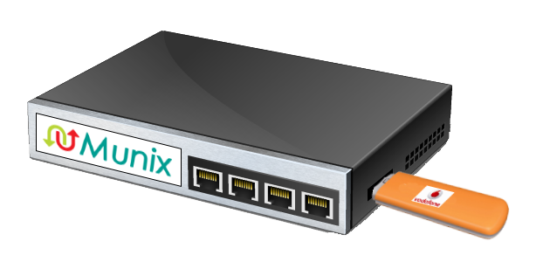
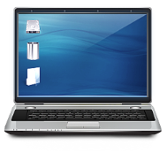
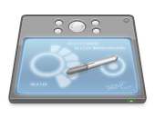

Off premises Infrastructure
Internet
Authentication, Accounting, Log &
Business Intelligence Analytics Server
4G Data card from Vodafone
Authentication,
Bandwidth Controlling & WiFi
Wireless Clients (Laptop, Tab & Mobile)
In Bus Infrastructure

Slide 4
How it works – User’s view
User sees WiFi Availability & connects the device
Device Pop-up with Authentication request
User enters the given password to access Internet
Munix Collects & Stores the log. It contains Device Information, MAC Address of the device, IP Address of Device, IP Address of visited sites and retains data for 18 months as per Govt. Norms.
On expiry, Munix forces user to logout

Slide 5
User Authentication Mechanism

Slide 6
Munix Web Management Portal
Web based authentication management system, with multiple user accounts & authority levels.
User can be created and password directly sent to user via SMS.
Provision to reset password and password directly sent to user via SMS.
Coupon management for onetime users with access time limitation.

Slide 7
Self Registration with Coupon
WiFi Users register themselves using the registration link available in the login page, but need coupon code.
Coupons are generated in Munix Web Management Portal.

Slide 8
Customized
Munix authentication solution can be customized to suit your unique requirements like subscribers, employee management system, membership systems, privilege customer, etc.
Application
  Organization with employee authentication system
  Club or any membership based programs
Advantages
  Controlled access
  Enhanced used experience
Challenges
  Requires technical support in integration
  Will attract additional development charges

Slide 9
Security

Slide 10
Munix Hotspot Security
Device Identification
  Detects most brands and models of Mobile & Tabs
Access Log
  Access Time
  Device MAC & IP Address
  IP Address & Port number of visited sites
Log Retention
  18 months as per the government norms

Slide 11
Additional Recommendations

Slide 12
Extend your work environment
IPSec site to site VPN Service
  Bus to Office IP Sec VPN Connection with exclusive work SSID
  VPN Users authenticated using your authentication mechanism (like you authenticate your users in your office)
Survey
  Forms to submit feedback / notifications
  Survey / Poll on various topics during journey time

Slide 13
Munix Completely customizable as per your unique requirements
Send live demo request mail to demo@munixlive.com,
with your convenient date & time for demo

Slide 14
Thank you very much for your valuable time

