Slide 1
Munix Fitness Centers
Customer Profiling, Attendance Management, SMS Alerts,
Workout Schedule, Diet Management, and much more ….
www.munixlive.com
info@munixlive.com
Internet Gateway & Business Intelligence

Slide 2
Agenda
Munix – How it works?
WiFi service in Fitness Center?
Contact

Slide 3
Munix – How it works?
Introduction & Architecture

Slide 4
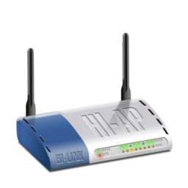
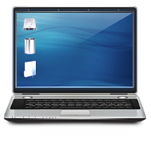
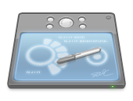
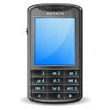
Off premises Infrastructure
Internet
Dual Internet
Connection
Authentication, Accounting, Log &
Business Intelligence Analytics Server
Optional
Local Server for
Apps, Online Sales, etc.
Wireless Access Point
Wireless Clients (Laptop, Tab & Mobile)
In premises Infrastructure

Slide 5
Profiling & Classification
Customer & their behavior Information
Business
Intelligence
Omicorn Engine
Automated Marketing

Slide 6
How it works – User’s view
User sees Free WiFi display & connects mobile
Mobile Pop-up with Authentication request
User enters login details.
Munix Redirects to “Todays Fitness Program” page
Customer’s attendance marked
Customer see their workout & diet chart
Diet related information sent by SMS at correct time

Slide 7
How it works – Service Provider’s view
Customer enrolls for Fitness Program
Login created and password sent directly to customer via SMS
Customer is assigned with “Todays Fitness Program”
Diet related information entered into Munix platform
Munix monitor their WiFi usage & log security related details

Slide 8
WiFi Service in Fitness Center

Slide 9
Services customized for Fitness Centers
Attendance Management System
Fitness Program for the day
Demonstration Videos
Diet Related Services/reminders
Subscription renewal reminders
Entertainment services
Feedback Management

Slide 10
Attendance Management System
Automatic report of present/absent customers
SMS reminders to absent customers
Access Anywhere
Allow customer to use any of your branch and manage their usage via WiFi based attendance system

Slide 11
Fitness Program for the Day
Pre-load the system with their workout chart
WiFi will suggest their workout schedule
Keep track of workout session using WiFi Service

Slide 12
Demonstration Videos
Allow customers to view demonstration videos of:
How to use fitness equipment
How to use Gym equipment
How to do exercises

Slide 13
Diet Related Services / Reminders
Help customer to attain their fitness goal
Show day wise diet chart
Send diet alert messages at correct time via SMS
For example send SMS at 11:30 am to take protein drink

Slide 14
Subscription Renewals
Remind customers about their subscription renewals
Send offers and special discount information
Customized links with customized price options
Online payment link via SMS
Send thank you message for completed renewals

Slide 15
Entertainment Service
Allow customer to avail entertainment using Internet Service
Internet based radio
Internet based songs like savan

Slide 16
Feedback Management
Allow customers to submit feedback forms:
Regarding the services
Periodical update regard progress in their goal
Suggestions for further improvement

Slide 17
Munix Completely customizable as per your unique requirements
Send live demo request mail to demo@munixlive.com,
with your convenient date & time for demo

Slide 18
Thank you very much for your valuable time

