Slide 1
Munix Healthcare
Customer Profiling, Frequency Analysis, Location Mapping, Movement Analysis, Web Classification, Time Analysis, and much more ….
www.munixlive.com
info@munixlive.com
Internet Gateway & Business Intelligence

Slide 2
Agenda
Munix – How it works?
WiFi service need in healthcare?
Advantages of WiFi Service
Contact

Slide 3
Munix – How it works?
Introduction & Architecture

Slide 4
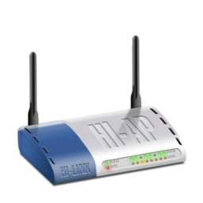
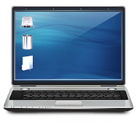
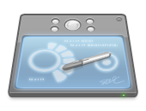
Off premises Infrastructure
Internet
Dual Internet
Connection
Authentication, Accounting, Log &
Business Intelligence Analytics Server
Optional
Local Server for
Apps, Online Sales, etc.
Wireless Access Point
Wireless Clients (Laptop, Tab & Mobile)
In premises Infrastructure

Slide 5
Profiling & Classification
Customer & their behavior Information
Business
Intelligence
Omicorn Engine
Automated Marketing

Slide 6
How it works – User’s view
User sees Free WiFi display & connects mobile
Mobile Pop-up with Authentication request
User selects “Self Registration” & Submit required details including Mobile number.
Munix Cloud delivers password by SMS
User uses the given password to access Internet
On expiry, Munix forces user to logout

Slide 7
How it works – Service Provider’s view
User uses the given password to access Internet
Munix Cloud logs usage
MAC address, Time, Sites Visited
Munix Analytics Engine Generates Reports
Profile customers using devices & social networks
Update frequency & time Analysis
Sends SMS alert to users regarding the products/Services
Location mapping & Movement Analysis
Generates Consolidation Reports

Slide 8
WiFi Service need in healthcare

Slide 9
Need for WiFi Service
Second largest country to use internet service
Mobile market share doubles every three years
Bandwidth need per person doubles every 18 to 24 months
4.0 hours average mobile internet usage per day
72% of web traffic generated by mobile users
2.5 hours average time spent on social media

Slide 10
Advantages of WiFi Service in healthcare
Do not mind to wait as waiting Time effectively used by patient/attenders.
Inpatients & their attenders can work remotely as most modern organizations support work from home.
Can download reports from labs instantly.
Update the status in Social Media instantly.
Can video chat with relatives to get moral support.
Builds database of patient, that can be used for marketing the new services.
Analytical reports can enlighten you in expanding the services.

Slide 11
Munix Completely customizable as per your unique requirements
Send live demo request mail to demo@munixlive.com,
with your convenient date & time for demo

Slide 12
Thank you very much for your valuable time

