Slide 1
Munix Saloon & SPA
Customer Profiling, Attendance Management, SMS Alerts,
Workout Schedule, Diet Management, and much more ….
www.munixlive.com
info@munixlive.com
Internet Gateway & Business Intelligence

Slide 2
Agenda
Munix – How it works?
WiFi service in Saloon
Omicorn Services
Contact

Slide 3
Munix – How it works?
Introduction & Architecture

Slide 4
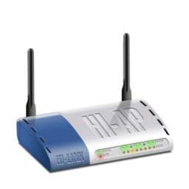
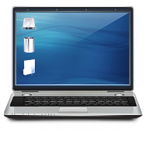
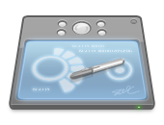
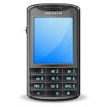
Off premises Infrastructure
Internet
Dual Internet
Connection
Authentication, Accounting, Log &
Business Intelligence Analytics Server
Optional
Local Server for
Apps, Online Sales, etc.
Wireless Access Point
Wireless Clients (Laptop, Tab & Mobile)
In premises Infrastructure

Slide 5
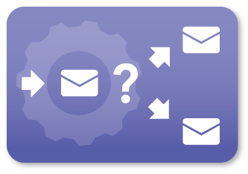
Profiling & Classification
Customer & their behavior Information
Business
Intelligence
Omicorn Engine
Automated Marketing

Slide 6
How it works – User’s view
User sees Free WiFi display & connects mobile
Mobile Pop-up with Authentication request
User enters login details.
Munix Redirects to “Todays Fitness Program” page
Customer’s attendance marked
Customer see their workout & diet chart
Diet related information sent by SMS at correct time

Slide 7
How it works – Service Provider’s view
Customer enrolls for Fitness Program
Login created and password sent directly to customer via SMS
Customer is assigned with “Todays Fitness Program”
Diet related information entered into Munix platform
Munix monitor their WiFi usage & log security related details

Slide 8
WiFi Service in Saloon / SPA

Slide 9
Services customized for Saloon / SPA
Style Information
Service Request Forms
Recommendation of Services
Discount Coupons
Entertainment services
Feedback Management

Slide 10
Service Information
Product / Service Catalog display
Comparison with others
Special Promotional Offers / Schemes
Upcoming Offers

Slide 11
Service Request Forms
Customer can choose required services
Bundle offers can be recommended
Q – Time information & Waiting time required

Slide 12
Recommendation of Services
Recommend right solution using
Customer Profile
Economic Status / Affordability
Previous service history

Slide 13
Discount Coupons
Send promotion offers using
Frequency of Visits
Average money spend on visits
Customer Profile
Economic Status / Affordability
Average time spent during visits

Slide 14
Subscription Renewals
Remind customers about their subscription renewals
Send offers and special discount information
Customized links with customized price options
Online payment link via SMS
Send thank you message for completed renewals

Slide 15
Entertainment Service
Allow customer to avail entertainment using Internet Service
Internet based radio
Internet based songs like savan

Slide 16
Feedback Management
Allow customers to submit feedback forms:
Regarding the services
Periodical update regard progress in their goal
Suggestions for further improvement

Slide 17
Omicorn Services

Slide 18
Automated Marketing
Promote business using
Automatic prediction of next service due
Appointment fixing by simple SMS reply
Discount or promotional coupon delivery
Based on number of visit
New trial service

Slide 19
Munix Completely customizable as per your unique requirements
Send live demo request mail to demo@munixlive.com,
with your convenient date & time for demo

Slide 20
Thank you very much for your valuable time

