Slide 1
Munix for Education
Content Filter, Bandwidth Control, Location Mapping, Movement Analysis, User Self Management Portal, Time Analysis, and much more ….
www.munixlive.com
info@munixlive.com
Internet Gateway & Business Intelligence

Slide 2
Agenda
Introduction
Munix – How it works?
Authentication Mechanism
Advantage of Munix in Education

Slide 3
Introduction to Munix
Munix is a WiFi based Business Intelligence Solution. It helps you to deploy WiFi Hotspot in your Institution premises and collect information regarding your users and their behavior.
Omicorn: Artificial Intelligence and Machine Learning Engine in Munix makes use of the collected information to achieve Business Intelligence reports and offer more insights in various ways.

Slide 4
Munix – How it works?
Introduction & Architecture

Slide 5
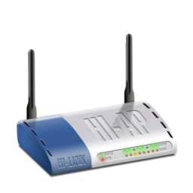
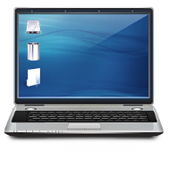
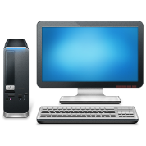
Off premises Infrastructure
Internet
Dual Internet
Connection
Authentication, Accounting, Log &
Business Intelligence Analytics Server
Optional
Local Server for
Apps, Online Sales, etc.
Wireless Access Point
Wireless Clients (Laptop, Tab & Mobile)
Wired Clients (Desktop, Server, etc.)
In premises Infrastructure

Slide 6
Profiling & Classification
Users & their behavior Information
Business
Intelligence
Omicorn Engine
Automated Marketing

Slide 7
How it works?

Slide 8
How it works – User’s view
User sees WiFi Availability & connects the device
Device Pop-up with Authentication request
User uses the given password to access Internet
On expiry, Munix forces user to logout

Slide 9
How it works – Instituion’s view
User uses the given password to access Internet
Munix Cloud logs usage
MAC address, Time, Sites Visited
Omicorn Engine Generates Additional Information
Profile the devices used by users
Update frequency & time Analysis
Sends SMS alert to users regarding the Services
Location mapping & Movement Analysis
Generates Consolidation Reports

Slide 10
User Authentication Mechanism

Slide 11
Student Login Management
Administrator of Institution creates login credentials for the first time. Munix automatically deliver password to students via SMS
Recommended Format
Registration number as username
Password auto generated and send via SMS
Further password management using mobile OTP

Slide 12
Guest Login Management
Administrator of Institution creates login credentials for the guests with limited time validity. Munix automatically deliver password to guests via SMS
Recommended Format
Guest Mobile number as username
Password auto generated and send via SMS
Further password management using mobile OTP

Slide 13
Advantages of Munix in Educational Institutions

Slide 14
Security
Each user is authenticated with individual credentials
Control over concurrent access for each user
Complete Log of Access Information
Munix Logs IP address, Ports, Sites visited & Device used for accessing the Internet Service

Slide 15
Effective Resource Management
Concurrent Access Control
Limit the number of concurrent login for each user
Bandwidth Control
User wise upload/download speed control
User wise upload/download data control

Slide 16
Content Filter Service
Complete control over content
Block unwanted websites like porn, illegal data, etc.
Log of access attempts
Know who attempts to violate the rules
Record of IP address and Date & Time of attempt
Blacklist / Whitelist Websites
Complete control over what users can access

Slide 17
User Self Service Portal
Easy self management portal
Allow user’s to manage themselves
Password change via mobile OTP authentication
Feedback / Contact forms
Payment option for Internet Service
Reporting
View reports regarding access
View reports regarding bandwidth usage

Slide 18
Munix Completely customizable as per your unique requirements
Send live demo request mail to demo@munixlive.com,
with your convenient date & time for demo,
Our representative will be in touch with you.

Slide 19
Thank you very much for your valuable time

