Slide 1
Munix Overview
Customer Profiling, Frequency Analysis, Location Mapping, Movement Analysis, VIP recognition, Time Analysis, and much more ….
www.munixlive.com
info@munixlive.com
Internet Gateway & Business Intelligence

Slide 2
Agenda
Introduction
Munix – How it works?
Internal Architecture
Authentication Mechanism
Password Delivery
Business Intelligence & Automation

Slide 3
Introduction to Munix
Munix is a WiFi based Business Intelligence Solution. It helps you to deploy WiFi Hotspot in your business premises and collect information regarding your customers and their behavior.
Omicorn: Artificial Intelligence and Machine Learning Engine in Munix makes use of the collected information to achieve Business Intelligence reports and promote your business in various ways.

Slide 4
Munix – How it works?
Introduction & Architecture

Slide 5
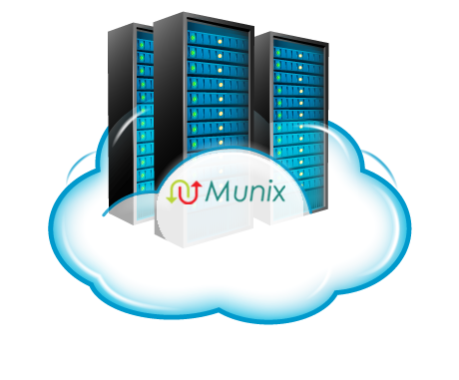
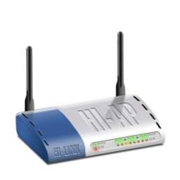
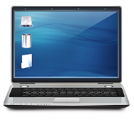
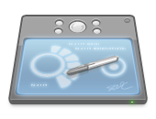
Off premises Infrastructure
Internet
Dual Internet
Connection
Authentication, Accounting, Log &
Business Intelligence Analytics Server
Optional
Local Server for
Apps, Online Sales, etc.
Wireless Access Point
Wireless Clients (Laptop, Tab & Mobile)
In premises Infrastructure

Slide 6
Profiling & Classification
Customer & their behavior Information
Business
Intelligence
Omicorn Engine
Automated Marketing

Slide 7
How it works – User’s view
User sees WiFi Availability & connects the device
Device Pop-up with Authentication request
User selects “Registration” & Submit required details including Mobile number.
Munix Cloud delivers OTP by SMS
User uses the given password to access Internet
On expiry, Munix forces user to logout

Slide 8
How it works – Service Provider’s view
User uses the given password to access Internet
Munix Cloud logs usage
MAC address, Time, Sites Visited
Omicorn Engine Generates Additional Information
Profile customers using devices
Update frequency & time Analysis
Sends SMS alert to users regarding the products/Services
Location mapping & Movement Analysis
Generates Consolidation Reports

Slide 9
User Authentication Mechanism

Slide 10
Self Registration
WiFi Users register themselves using the registration link available in the login page.
Application
Café, Restaurant, Shopping Mall, Hospitals, etc.
Advantages
No intervention required from the organization
Challenges
Anybody can avail the WiFi service

Slide 11
Self Registration with Coupon
WiFi Users register themselves using the registration link available in the login page, but need coupon code.
Application
Café, Restaurant, Hotels, Shopping Mall, Hospitals, etc
Advantages
Controlled access as coupon required for registration
Challenges
Requires facility to supply coupons to WiFi Users

Slide 12
Service KIOSK
Self/Assisted registration using KIOSK (one of your computer may also be used as KIOSK).
Application
Café, Restaurants, Hotels, Shopping Mall, Hospitals, etc
Advantages
Controlled access as registration done at KIOSK
Challenges
Requires facility/manpower to help registration

Slide 13
Third Party Software Integration
Munix will be connected to external third part software solution like Hotel Management System or Hospital Management System or Loyalty Programs. Munix Automatically authenticate software users.
Application
Restaurant, Hotel, Resorts, Hospitals, Retail Outlets, etc.
Advantages
Controlled, access only for validated guests
Challenges
Requires support from third party software vendor

Slide 14
Customized
Munix authentication solution can be customized to suit your unique requirements like subscribers, membership systems, privilege customer, etc.
Application
Club or any membership based programs
Advantages
Controlled access
Enhanced used experience
Challenges
Requires technical support in integration
Will attract additional development charges

Slide 15
Password Delivery

Slide 16
Password Delivery Options & Challenges
Coupons
Pre-printed coupons may be given to users.
SMS – Short Message Service
Password directly delivered to user’s mobile via SMS
Challenges in SMS
Customer should have connectivity to receive SMS
Sending SMS to foreign numbers will be costly
Foreigners can obtain mobile connection only after 24 hours of stay within India

Slide 17
Business Intelligence, Automated Marketing & Reporting

Slide 18
Munix Business Intelligence Reporting
Customer Database Building & Profiling
Builds customer database with mobile no confirmation
Profiles customer using device & Access details
Frequency of visit & Time Spent – Reports
Store Related Reports
Busy & Idle resource recognition
Customer movement analysis
VIP recognition

Slide 19
Automated Marketing
Automatic Marketing based on various conditions
Based on number of visits
No Show period
Length of Stay within your premises
Omicorn Services
Promotion based on learnings
Customer requirement predictions

Slide 20
Munix Completely customizable as per your unique requirements
Send live demo request mail to demo@munixlive.com,
with your convenient date & time for demo,
Our representative will be in touch with you.

Slide 21
Thank you very much for your valuable time

